Slide 1
Project :Credit Card Application Chatbot by Adrian, Eric, Saiful, Shrenik and Tarang

Slide 2
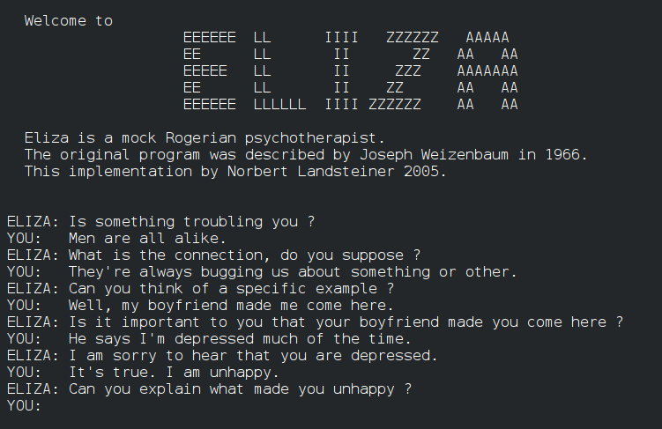
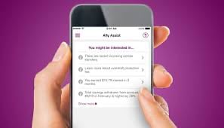
Brief History of Chatbot:
ELIZA was the very first chatbot as mentioned above. It was created by Joseph Weizenbaum in 1966 and it uses pattern matching and substitution methodology to simulate conversation.
Ally Bank was one of first who started to use Chatbots for Personalized customer service in 2015.

Slide 3
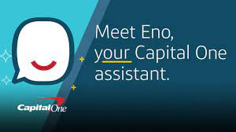
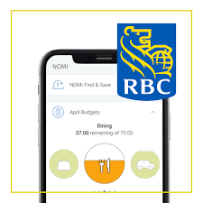
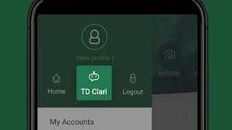
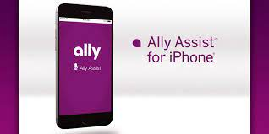

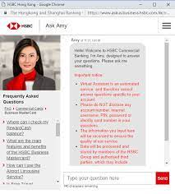
Chatbots used by Financial Institutes
Ally Assist by Ally Bank
Amy by HSBC
Ceba by Commonwealth Bank (Australia)
Citi Bot SG by Citi
Clari by TD
Eno by Capital One
Nomi by RBC
Scotia Bank Chatbot

Slide 4
Project analysis slide 2
Project Objective To create a chatbot that can run a credit application to test credit worthiness and suggest various credit cards and loans.
Use data from Kaggle
Using Using Amazon Sagemaker, Train and slit test to develop models & visualization to evaluate performance.
PROJECT
Using Amazon Lex to build chatbot, eg; Intent, Utterance ,slots etc.
Create presentation showcasing the model & chatbot.
Create a summary of the Project
Implement Data into Chatbot.

Slide 5
Project analysis slide 3
Project Tasks
Finding Data
Train & Test data
Build the Chatbot
Plug model into chatbot
Run the Chatbot
Using Amazon Sagemaker
Build chatbot using Amazon Lex
Connecting Amazon Sagemaker with Amazon Lex

Slide 6
Thank You

